Slide 1


Combating Misinformation: Zero-Shot Models for Fake News Detection
Sajin Mahmud Arpon (22-46629-1)
Md Ariful Islam (22-46139-1)
Mir Md Mofakkar Hossain (22-46245-1)
Supervised by
Dr. Mohammad Saef Ullah Miah

Slide 2
Index
Introduction
Literature Review
Methodology
Result & Analysis
Conclusion & Future Work
References

Slide 3

Introduction
Fake News Challenge
Rapid spread on social media influences opinions and undermines institutions.
Supervised Method Limitations
Require large labeled datasets and often fail on novel topics.
Zero-Shot Learning (ZSL)
Classifies unseen data without task-specific training, adapting to new themes.
Study Goal
Evaluate three zero-shot models and a soft-voting ensemble on BuzzFeed News.

Slide 4
Literature Review
Naïve Baselines
ML Lexical Approaches
LLM-based Advances
Research Gap
Granik & Mesyura (2017) achieved ~74% accuracy with Naïve Bayes on Facebook posts.
Few studies systematically assess zero-shot classifiers for fake news detection.
Ahmed et al. (2017) used n-gram + LSVM, showing limited deep semantic understanding.
Wang et al. (2024) introduced "L-Defense," a prompt-based LLM system with high accuracy.

Slide 5
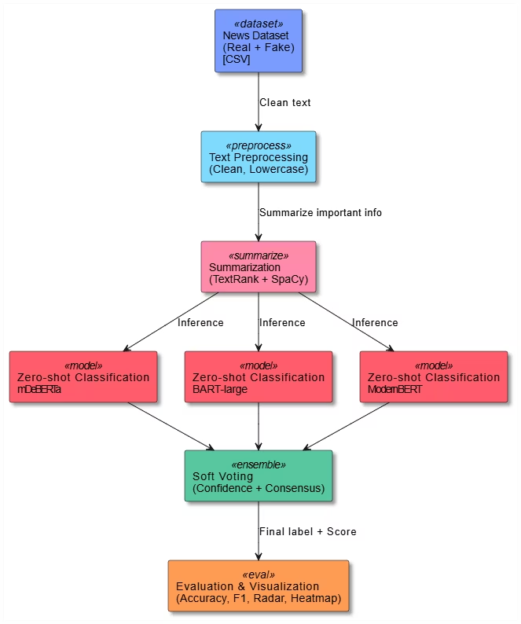






Methodology
Dataset
Labeled real vs. fake news articles in CSV format.
Preprocessing
Text cleaning and lowercasing for consistency.
Summarization
Extractive TextRank via spaCy for key information.
Classification
Zero-shot models: mDeBERTa, BART-large/MNLI, ModernBERT.
Ensemble
Soft-voting averages model probabilities for robust results.
Evaluation
Accuracy, F1 score, visualized with radar chart and heatmap.

Slide 6

Data Preprocessing
Dataset Source
Summarization
BuzzFeed News articles from FakeNewsNet/Kaggle, accessed via Google Colab.
Input data were summarized news texts to reduce noise and focus on content.
1
2
3
Cleaning Process
Removed records with missing text fields; ensured all text entries are strings.

Slide 7

Model Architectures
ModernBERT (Modern BART ZSC)
mDeBERTa
BART Large (MNLI)
Multilingual DeBERTa-based zero-shot classifier. Fine-tuned on MNLI/XNLI for cross-lingual NLI.
BART model pre-trained on NLI data. Frames class labels as hypotheses for entailment.
Prompt-based BART variant for zero-shot classification. Converts labels to natural language.

Slide 8

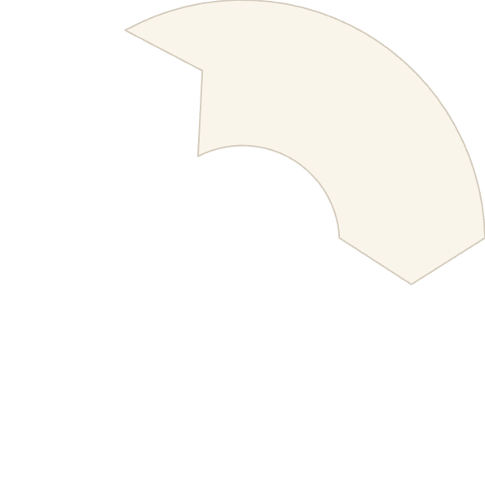




Ensemble Strategy
Decision Rule
Average scores; if ≥0.5, label as "real," else "fake."
Soft Voting Ensemble
Combines model outputs by averaging their confidence scores (0-1).
Rationale
Lightweight ensemble leverages model complementarity for robust predictions.

Slide 9





Evaluation Metrics
Accuracy
Precision
Recall
F1 Score
Overall correct classifications.
Proportion of true positive predictions.
Proportion of actual positives identified.
Harmonic mean of precision and recall.
MAE
Mean Absolute Error, lower is better.

Slide 10
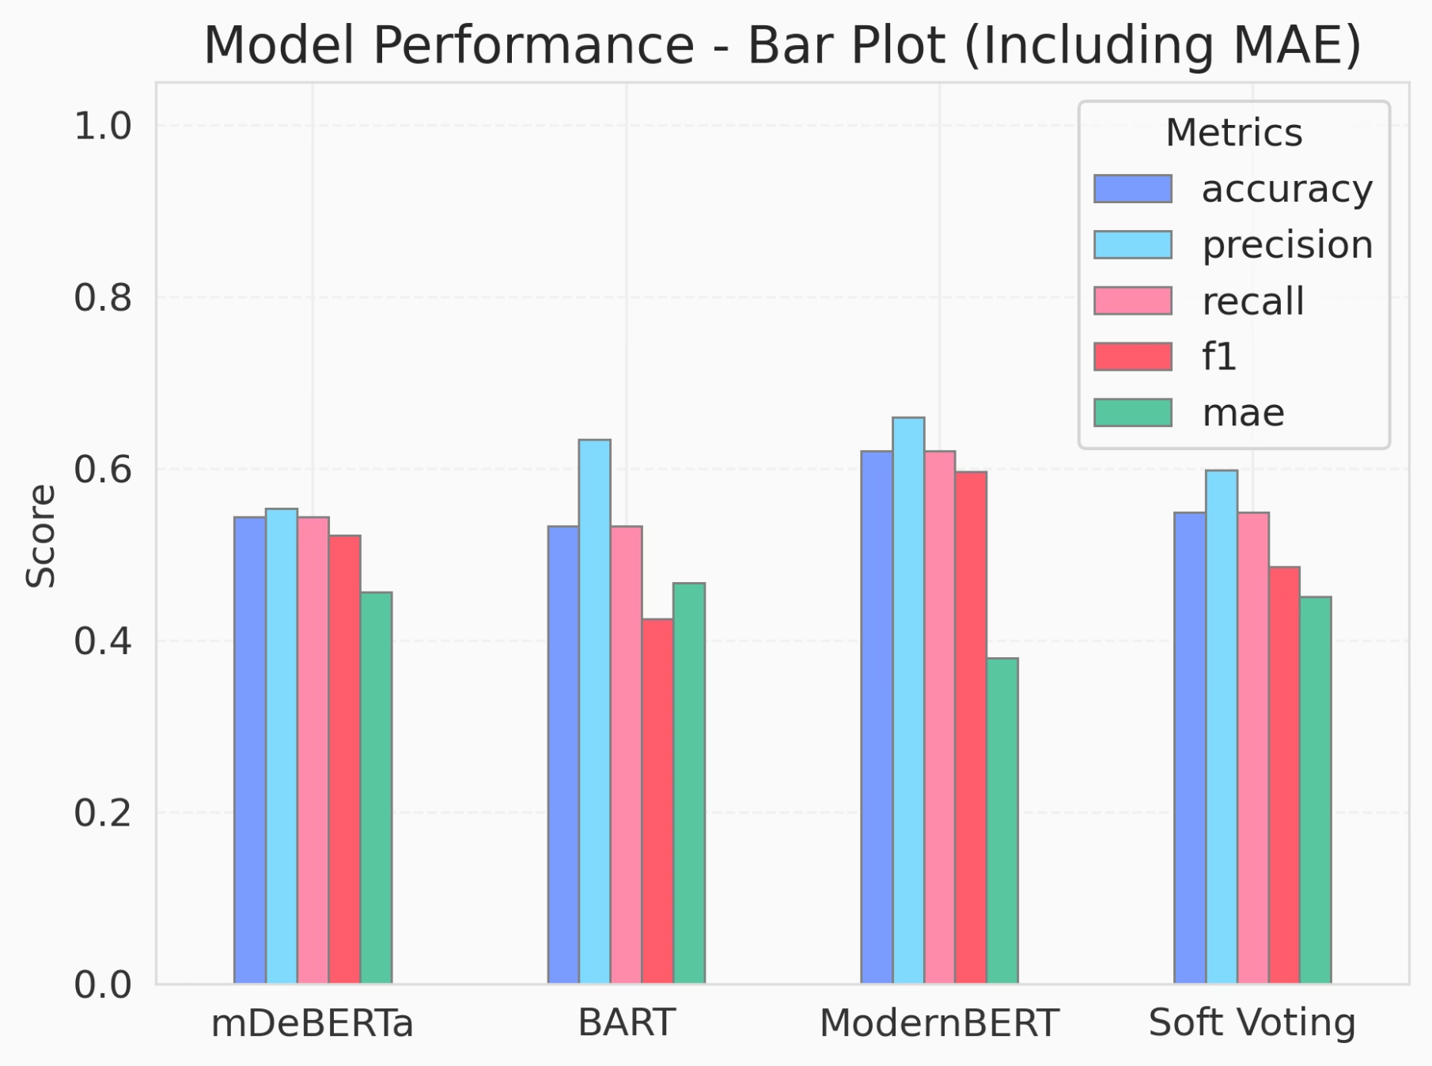
Result and Analysis
ModernBERT achieves the highest scores on accuracy, precision, recall, F1, and has the lowest MAE. The ensemble’s bars lie between ModernBERT and the other two models.

Slide 11
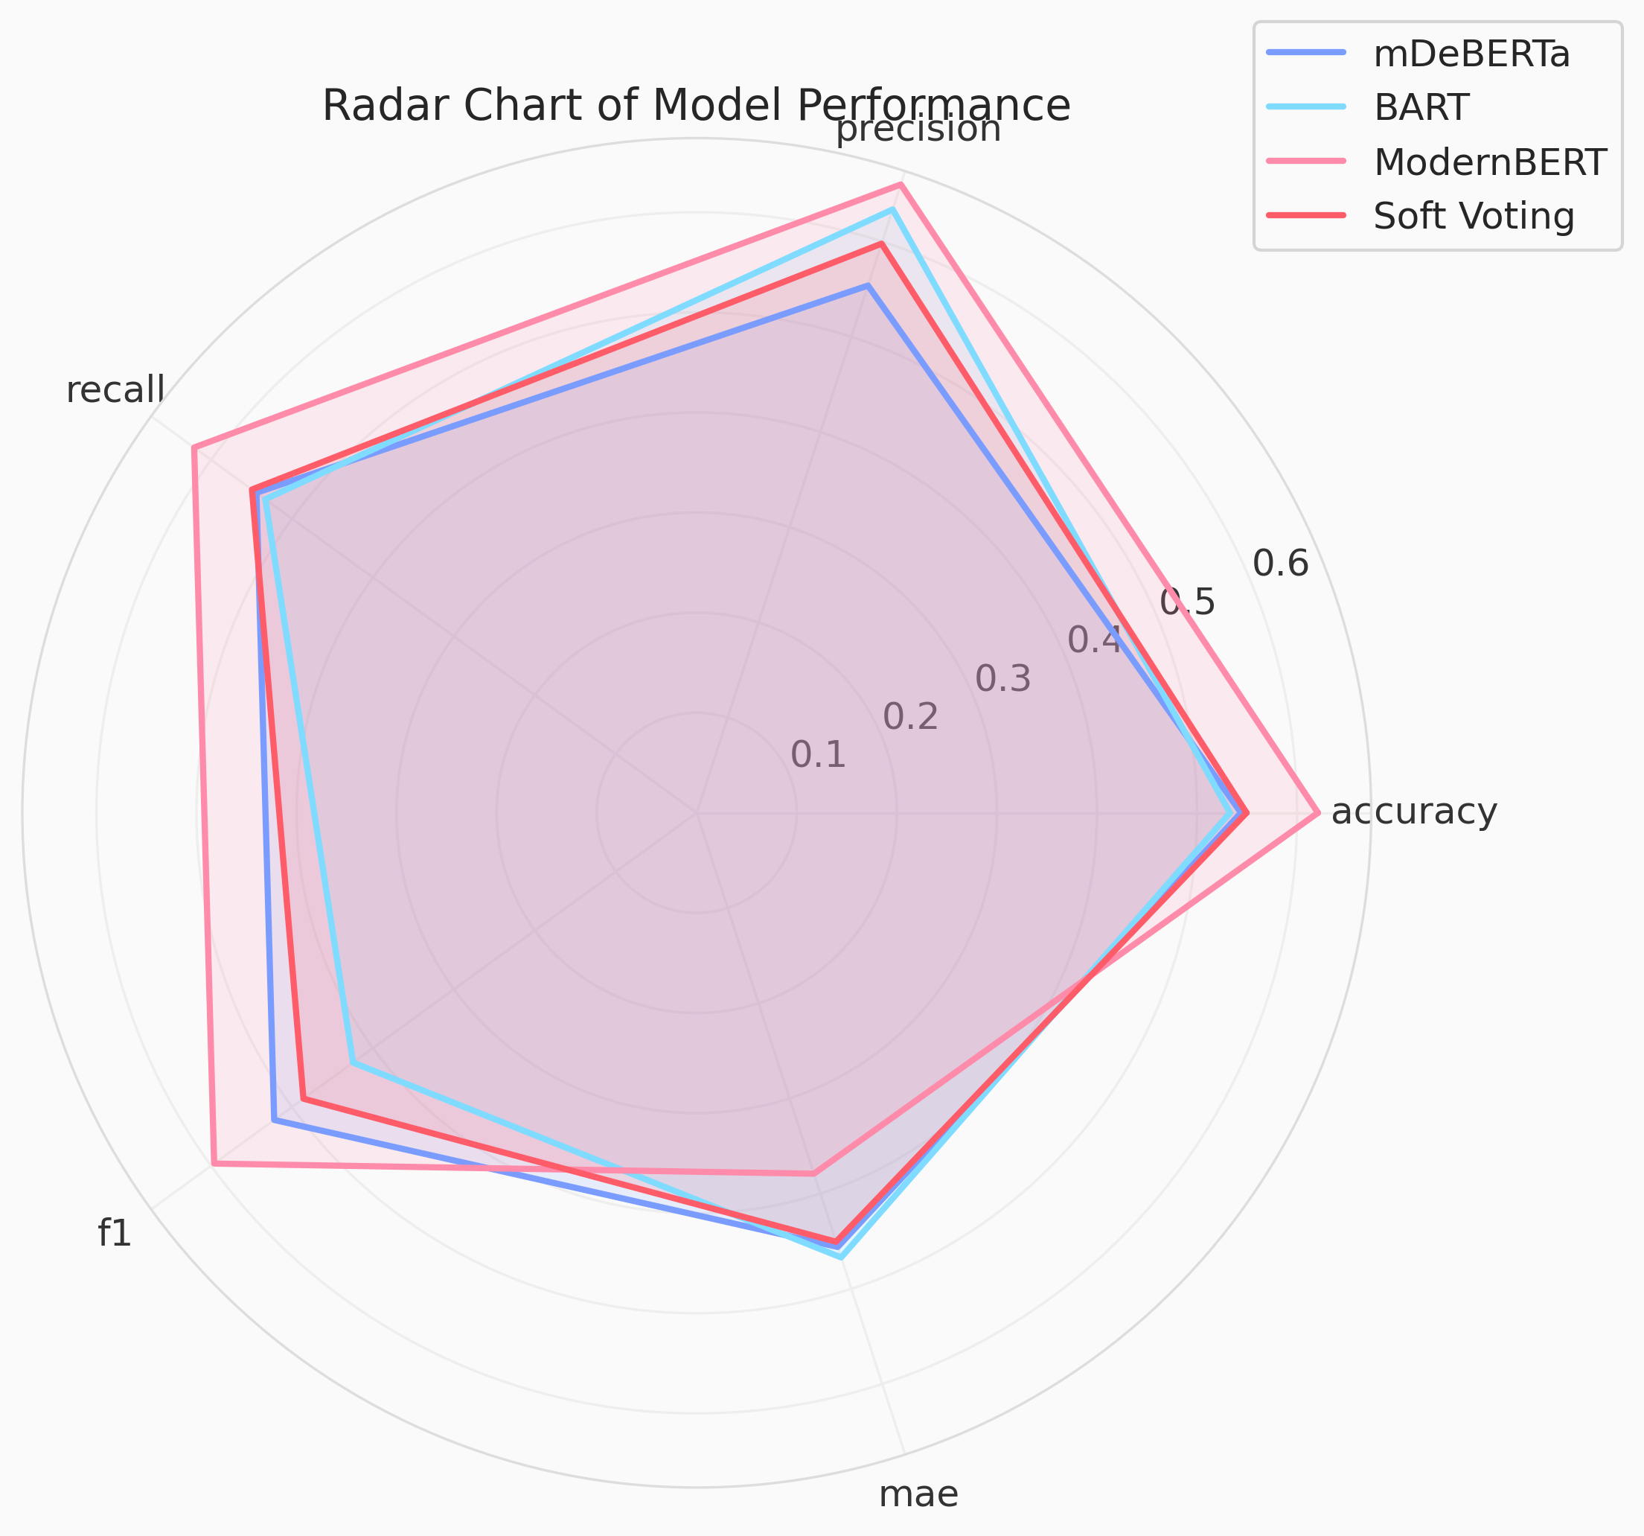
Result and Analysis
ModernBERT's polygon extends furthest on all positive-metric axes accuracy, precision, recall, F1). The ensemble's shape is more balanced/circular (moderate on all metrics), while BART/mDeBERTa have smaller, irregular polygons.

Slide 12
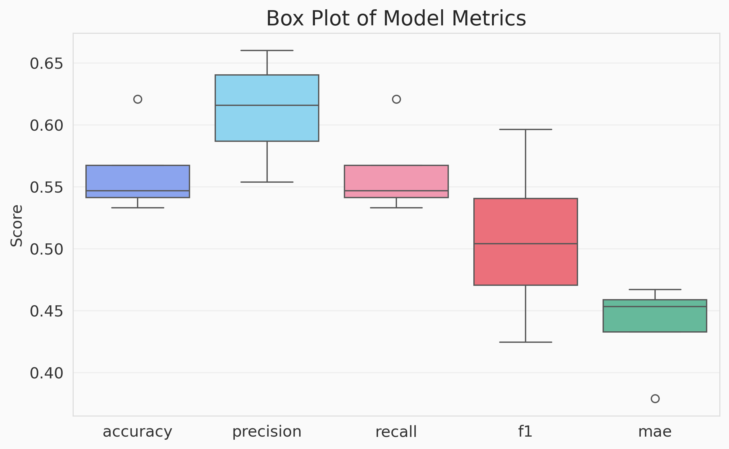
Result and Analysis
ModernBERT shows the narrowest interquartile ranges (IQRs) and fewest outliers across metrics. BART and mDeBERTa have wider boxes (higher variance). The ensemble’s box sizes lie between ModernBERT and the older models, reflecting improved consistency.

Slide 13
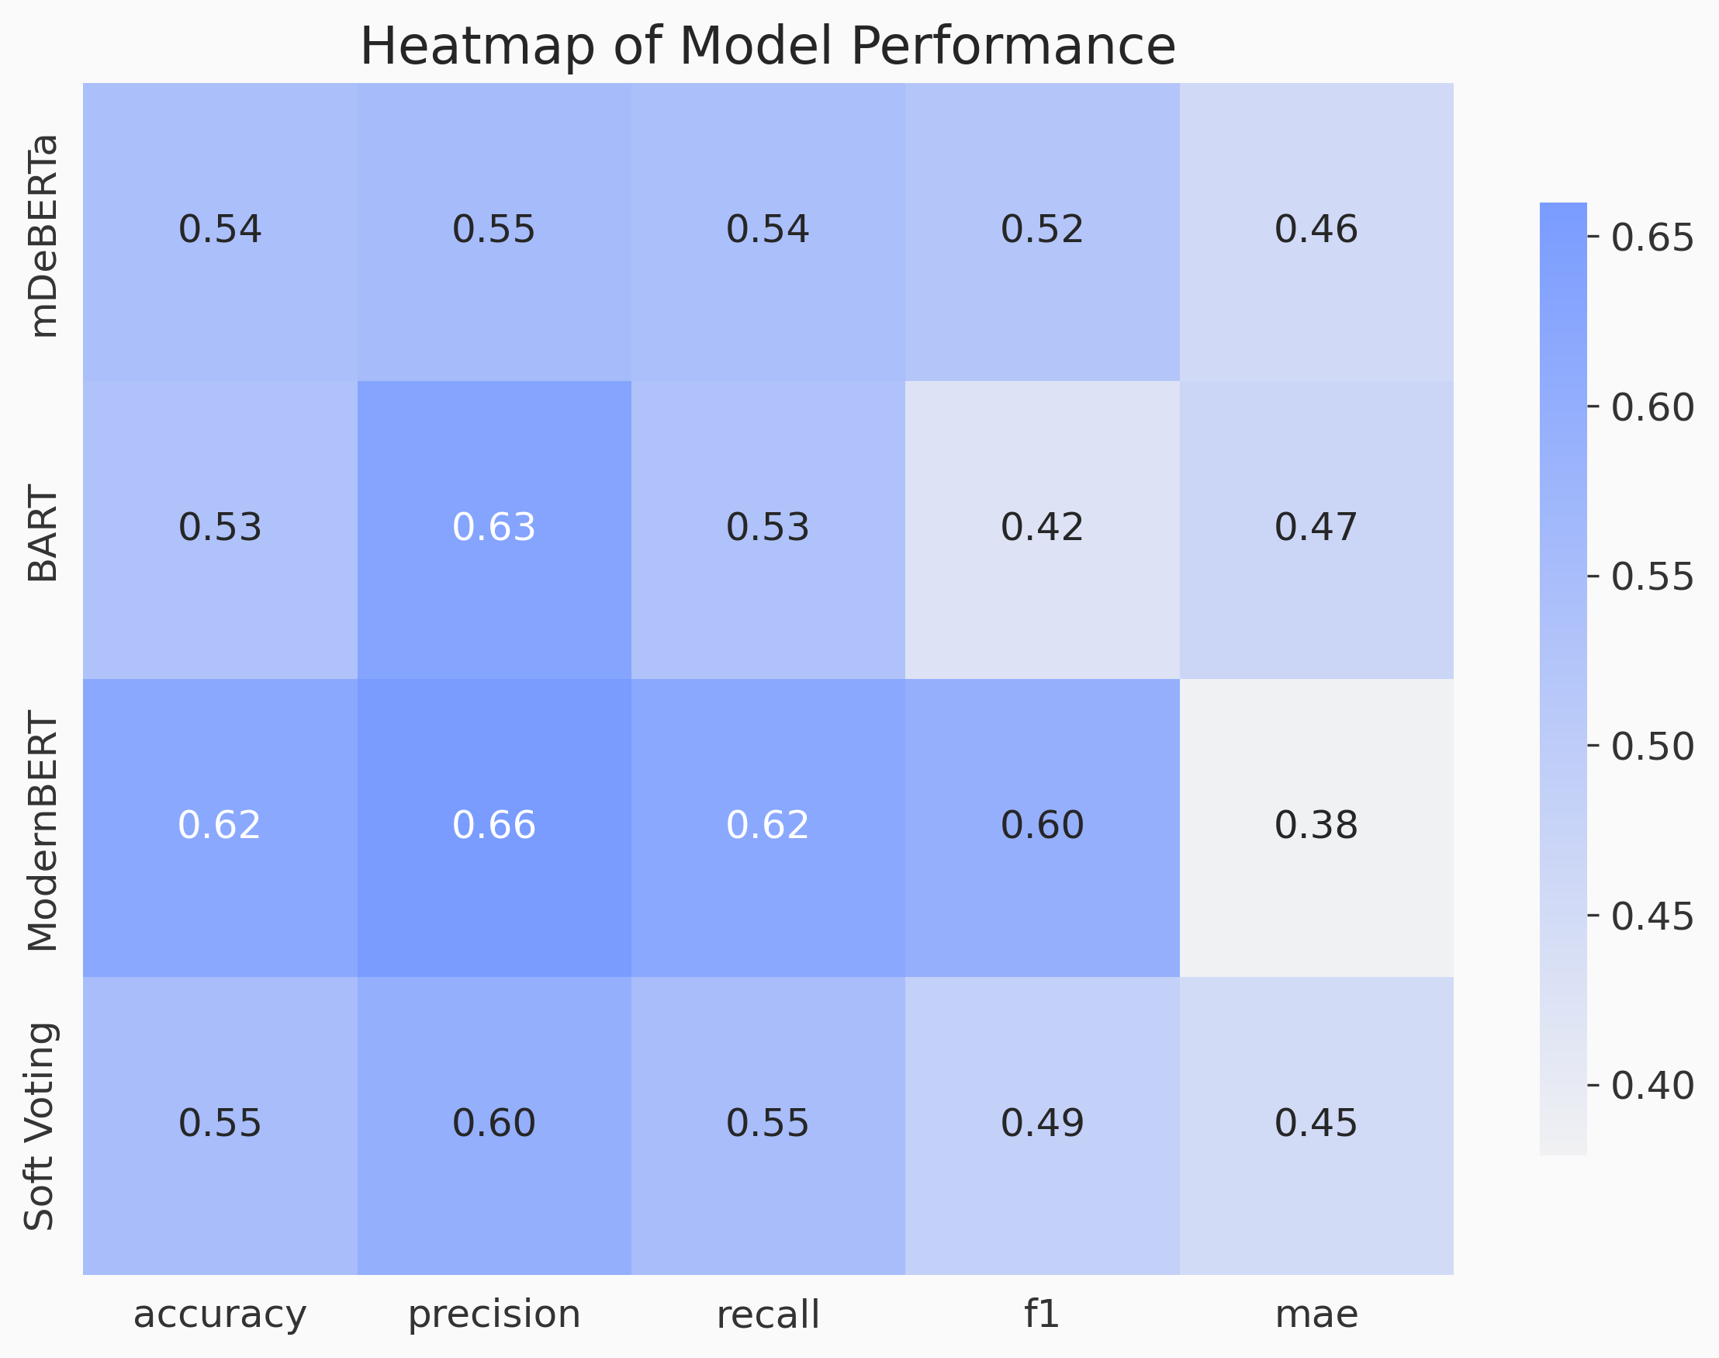
Result and Analysis
Darker blue cells mark ModernBERT’s top values (including the lightest shade at MAE=0.38). The ensemble row has intermediate shades; BART/mDeBERTa rows show lighter blues on key metrics and darker on MAE (higher error).

Slide 14
Conclusion & Future Work
Key findings: Among the evaluated methods, ModernBERT achieved the best results: Accuracy=0.62, Precision=0.66, Recall=0.62, F1=0.60, MAE=0.38. Comprehensive visual and numerical analyses consistently validate ModernBERT’s superiority.
Ensemble results: The soft-voting ensemble outperformed BART and mDeBERTa (especially in lowering MAE) but still fell short of ModernBERT’s scores.
Limitations: A drawback of zero-shot models is the lack of domain-specific tuning. this can occasionally cause misclassifications in specialized contexts.
Future directions: Integrate explainable AI techniques (e.g., token-level attribution, attention-map visualization) to increase transparency. Enhanced interpretability will help stakeholders (fact-checkers, journalists) trust the system. Reducing misclassifications via explainability is a promising next step.

Slide 15
Reference
R. Baashirah. Zero-shot Automated Detection of Fake News: An Innovative Approach. IEEE Access, 2024file-na6ru5rhtb8rx3pn5re6q9.
BuzzFeed News. Fake News (Kaggle Data), 2025.
M. Granik & V. Mesyura. Fake News Detection Using Naïve Bayes Classifier. Global Journal of Computer Science and Technology, 2017file-na6ru5rhtb8rx3pn5re6q9.
P. He, X. Liu, J. Gao, & W. Chen. DeBERTa: Decoding-enhanced BERT with Disentangled Attention. ICLR 2021file-na6ru5rhtb8rx3pn5re6q9.
B. Wang et al. Explainable Fake News Detection with Large Language Model via Defense Among Competing Wisdom. Proc. ACM Web Conf. (WWW) 2024file-na6ru5rhtb8rx3pn5re6q9.
Y. Yin, B. Roth, & I. Gurevych. Benchmarking Zero-Shot Text Classification: Datasets, Evaluation and Entailment Approach. EMNLP 2019

